Slide 1
Online book review
230 Java SL KK batch : Group number - 03
Group details:
2563926 | Allam Himasree
2563997 | Amulya S
2564415 | Chanagoni Tejaswini
2563778 | Chebrolu Sai Krishna ( Team Lead )
2564262 | Dinesh kumar M
2563966 | Kameshwaran K
2563246 | Konkimalla Asish
2563065 | Megha C

Slide 2
Table of contents
Project objective
Technology stack
Database Schema
Admin
Login to Portal
Remove book details from the application along with their price
Add book new details
Edit book details like name, price, seller, author, and description to keep the book information updated with the current prices and Enable or disable the books
Admin should see all the ratings by the user for particular book
User
Register into the application
Sign into the application to maintain the record of activities
Update Profile
List all the enabled books to the user
Search for books based on the search keyword.
Review the available books and user should see past reviews for the book

Slide 3
1.Project objective
Create a dynamic and responsive Java full stack web application to build a book review website

Slide 4
2.Technology stack
Front-End: Angular , Bootstrap , HTML
Server-side: Spring Boot
Spring web
Spring data JPA
Spring MySQL connector
Lombok
Back-end: MYSQL, Hibernate, Java v1.8
IDE – Spring Tool Suite v4.18
Server: Tomcat v8.5

Slide 5
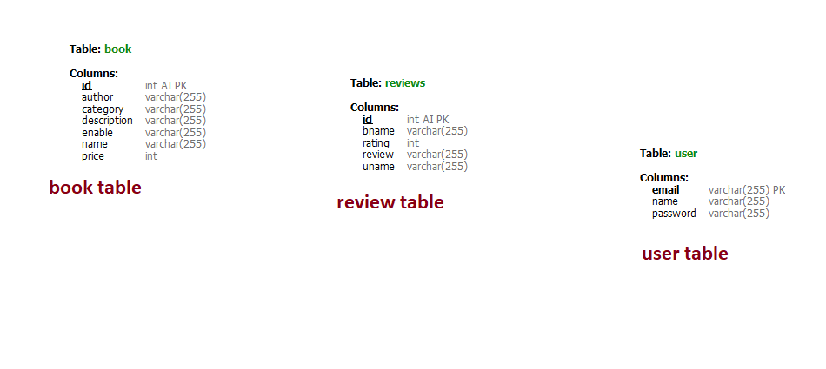
3.DataBase schema

Slide 6
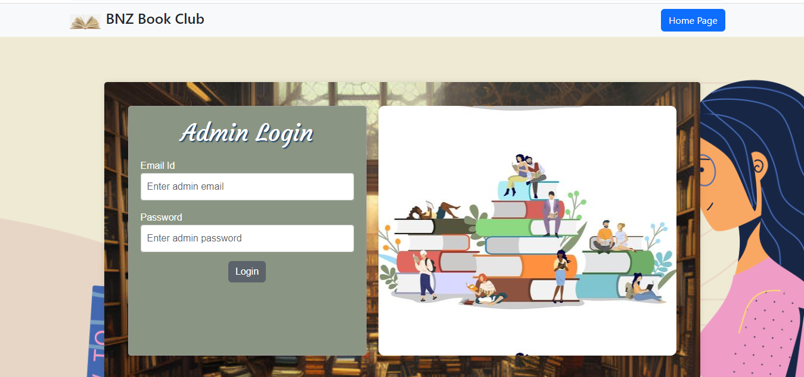
4.1 Admin Login
Admin can login with email and password

Slide 7
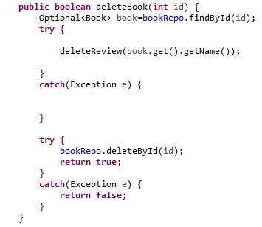
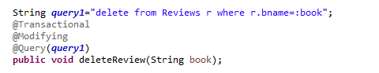
4.2 Remove Book details
Post Man API request - Delete - http://localhost:4200/deleteBook/1
Spring boot code –
Book is deleted along
with all reviews given to
that book.

Slide 8
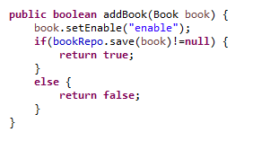
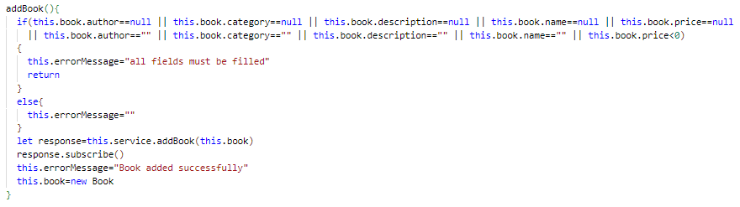
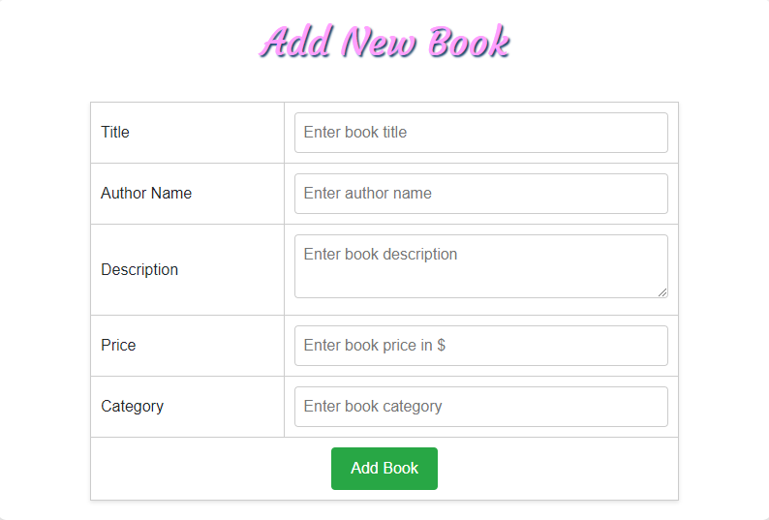
4.3 Add new book
Post Man API request - Post- http://localhost:4200/addBook/1
Spring boot code –
Book is added to the data
base only if all book details are
filled
Typescript validation:-

Slide 9
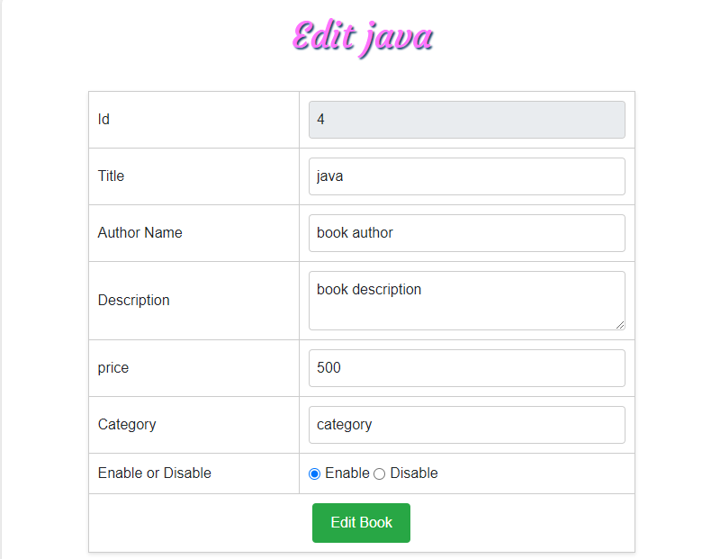
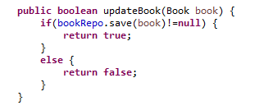
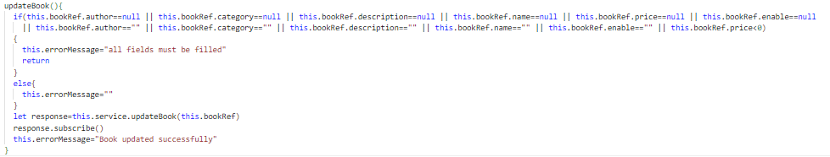
4.4 Update Book Details
Post Man API request - Put- http://localhost:4200/updateBook
Spring boot code –
Book is updated in
the database
Typescript validation:

Slide 10
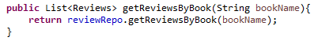
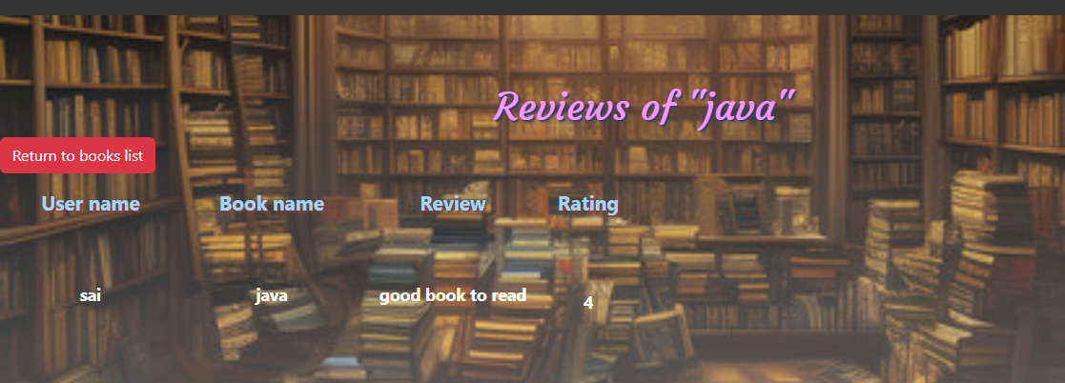
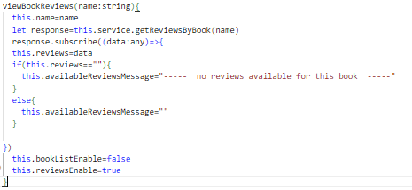
4.5 view all rating by a user for a particular book
Post Man API request - Get- http://localhost:4200/getReviewByBook/java
Spring boot code –
All reviews for a particular book
is retrieved in reviews table
Typescript code :

Slide 11
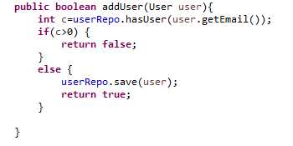
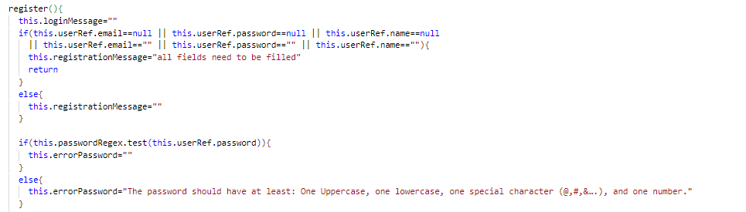
5.1 User registration
Post Man API request - Post- http://localhost:4200/addUser
Spring book code -
User get registered only if
the email is not present in
the database
Typescript validation:

Slide 12
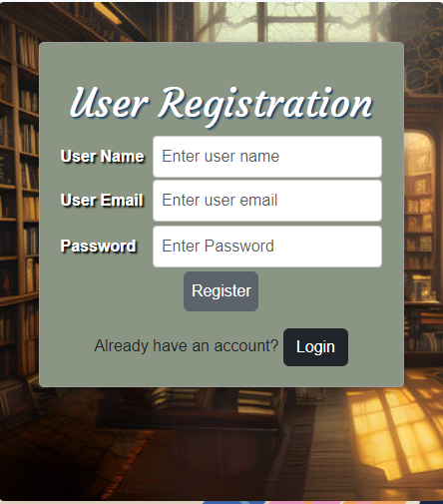
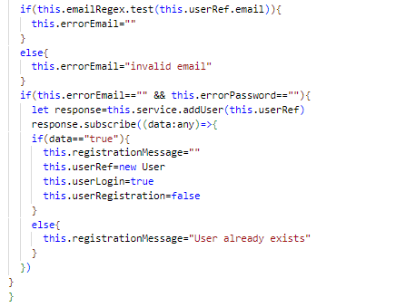
5.1 User Registration - continue
Typescript code -

Slide 13
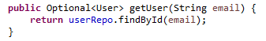
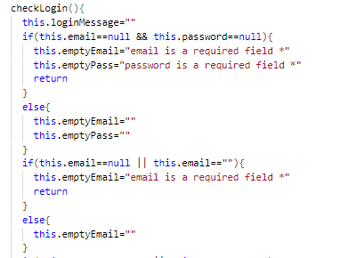
5.2 User Login
Post Man API request - Get - http://localhost:4200/validateUser/email/password
Spring boot code –
Check whether give details
are mapped with that email are correct
Typescript validation :

Slide 14
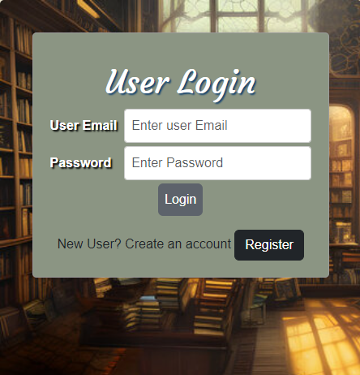
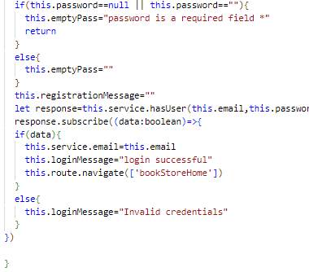
5.2 User login - continue
Typescript validation –

Slide 15
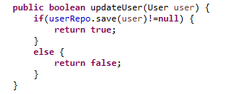
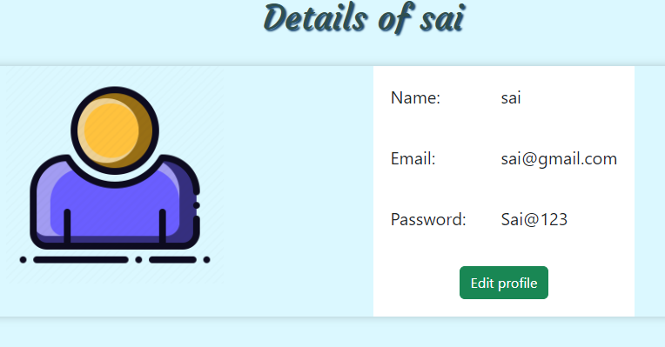
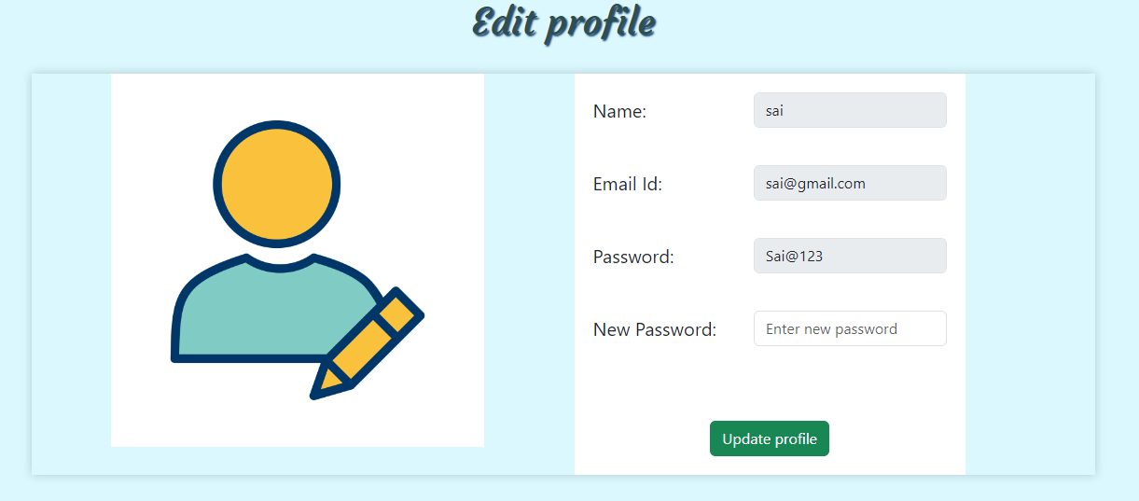
5.3 Update profile
Post Man API request - Put - http://localhost:4200/updateUser
Spring boot code –
User is updated with
a new password

Slide 16
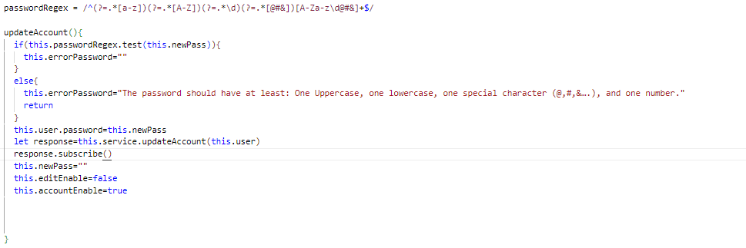
5.3 Update profile -continue
Typescript validation:

Slide 17

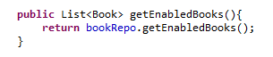
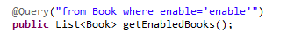
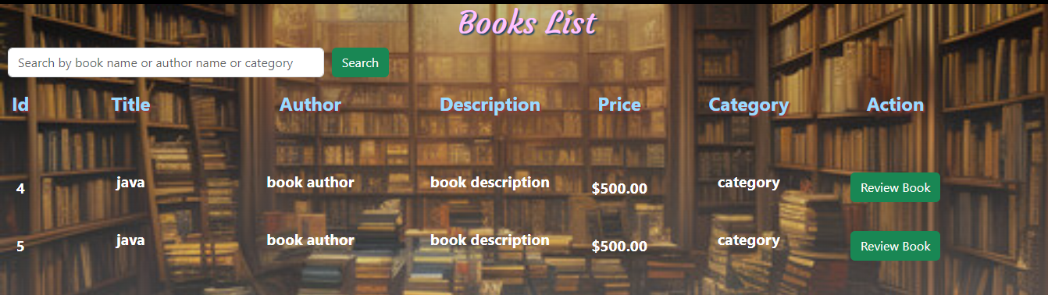
5.4 Enabled book list
Post Man API request - Get - http://localhost:4200/getEnabledBooks
Spring boot code –
Book are displayed to the
User that are enabled by admin

Slide 18
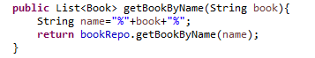
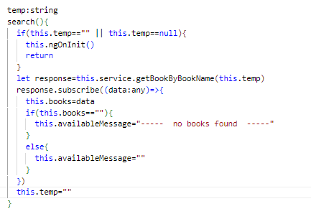
5.5 Search of books by book,author,category
Post Man API request - Get - http://localhost:4200/getBookByBookName/book
Spring boot code –
Typescript -

Slide 19
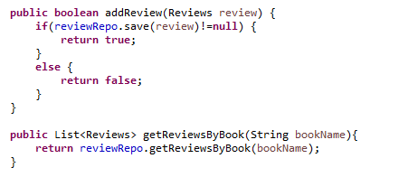
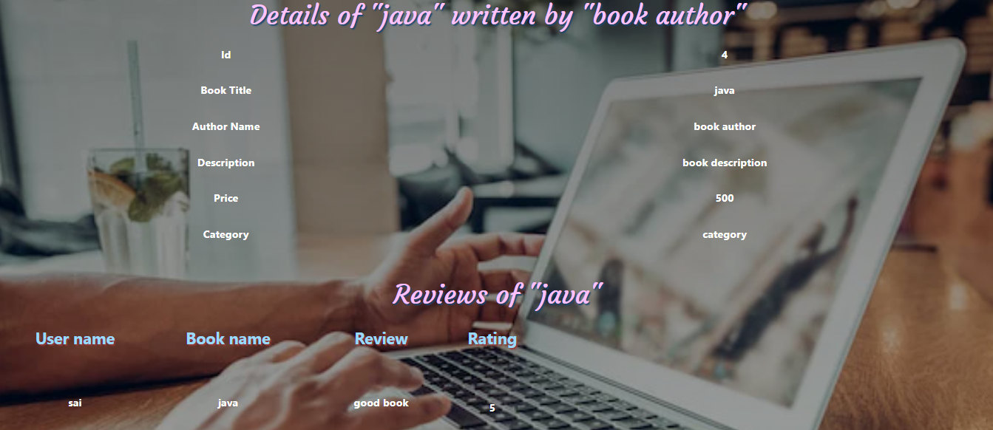
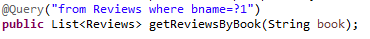
5.6 Review the available books and user should see past reviews for the book
Post Man API request - Get - http://localhost:4200/getReviewByBook/book
Post Man API request - Post – http://localhost:4200/addReview
Spring boot code -
Before user review a book ,
user can see the past reviews for
the book

Slide 20
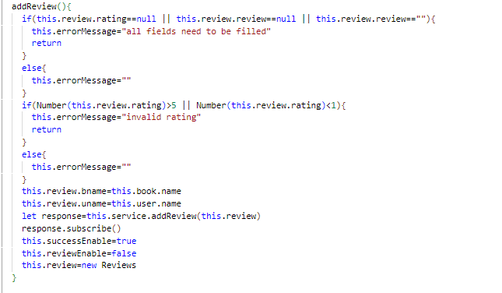
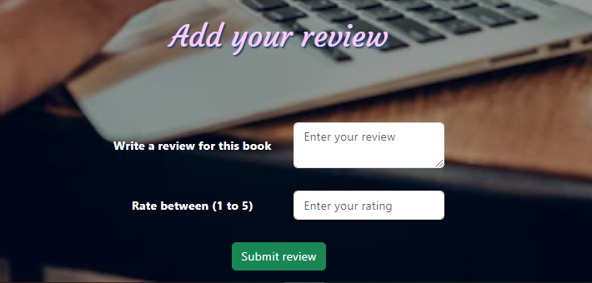
5.6 Review the available books and user should see past reviews for the book
Typescript code -

Slide 21

Queries ?

Slide 22

Thank you

